Slide 1
Durable Computing 101
With Postgres and Python
Execution
Harry Pierson
harry.pierson@dbos.dev
@devhawk.net

Slide 2


Slide 3


Slide 4
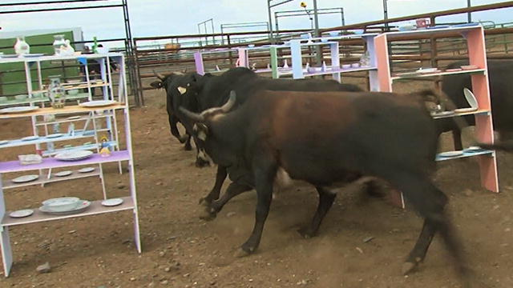


Slide 5

“Remember kids, the only difference between screwing around and science is writing it down”
Adam Savage
Notes:
https://www.youtube.com/watch?v=BSUMBBFjxrY

Slide 6
“Remember kids, the only difference between screwing around and science is writing it down”
a reliable
system
Adam Savage
…in durable storage
& Harry Pierson
Notes:
https://www.youtube.com/watch?v=BSUMBBFjxrY

Slide 7
Memory == Volatile == Unreliable
Durable Storage == Nonvolatile == Reliable
Reliability comes from
durably storing critical system state
so that it can survive a system crash.
Aren’t we already doing this?
We use Postgres!

Slide 8
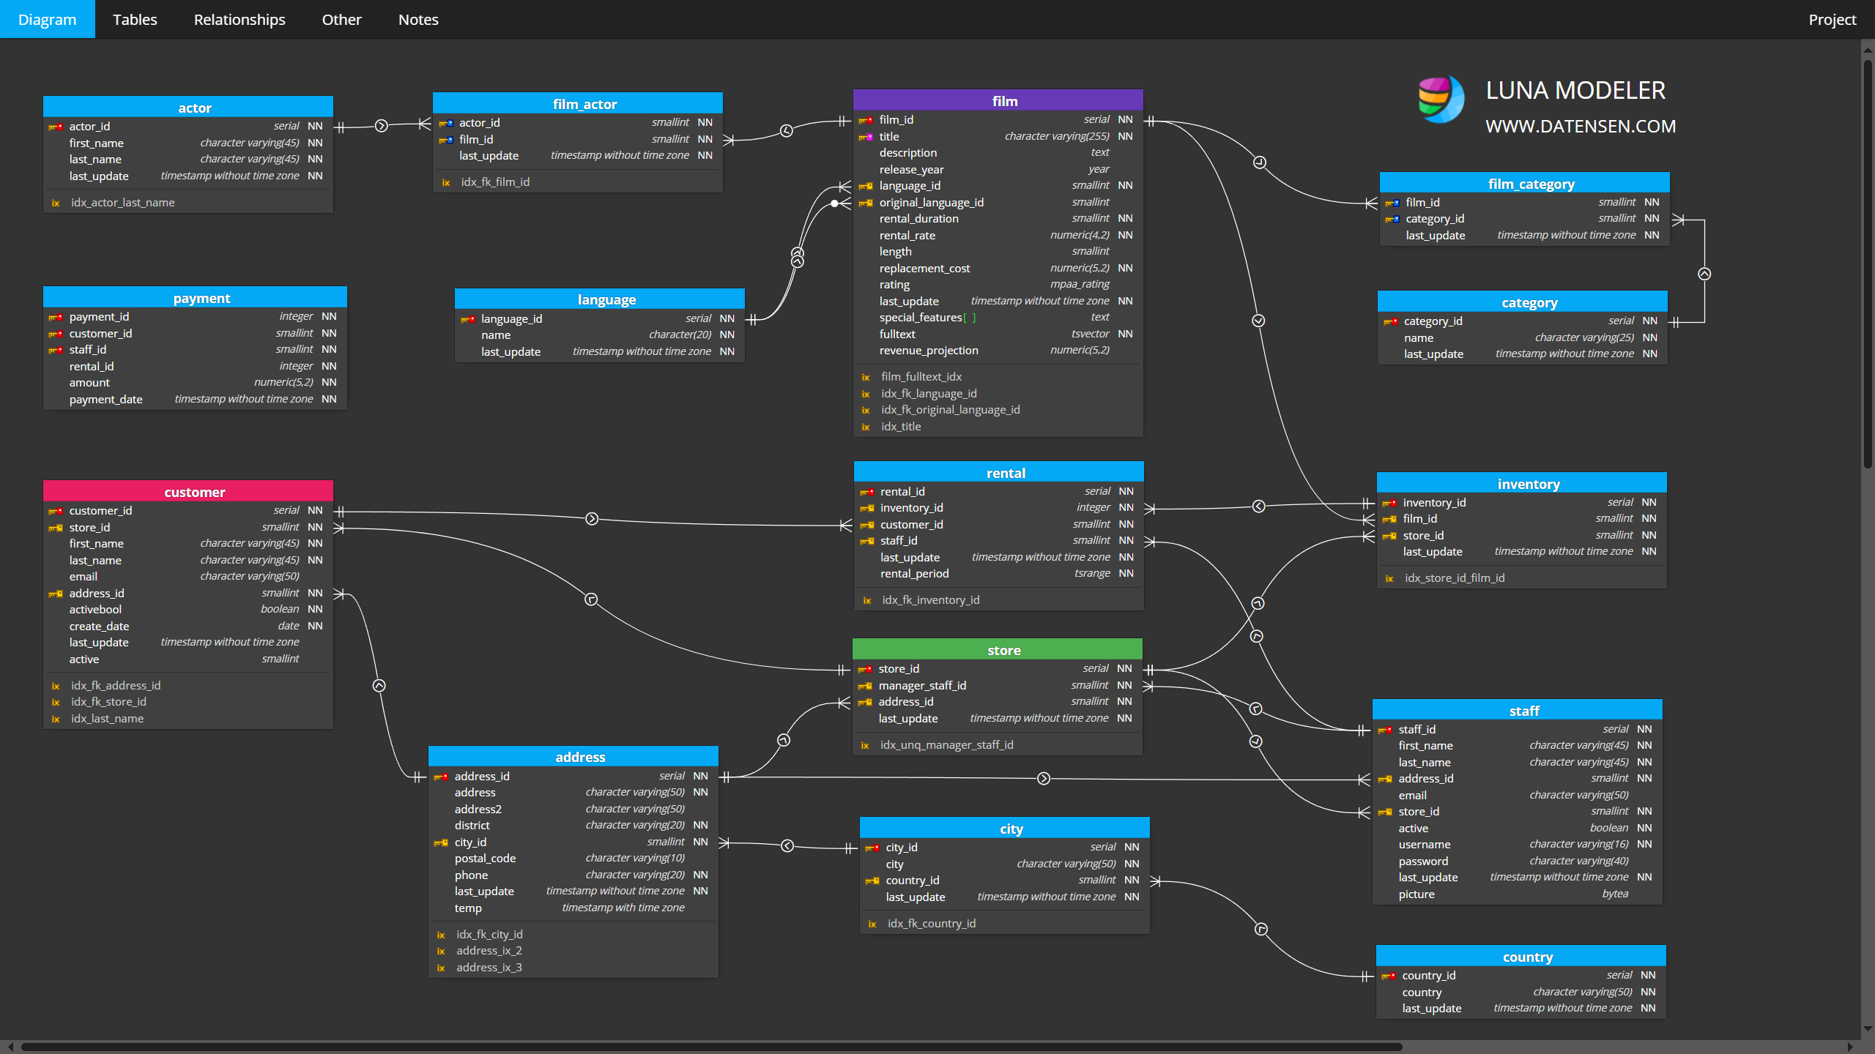

Slide 9
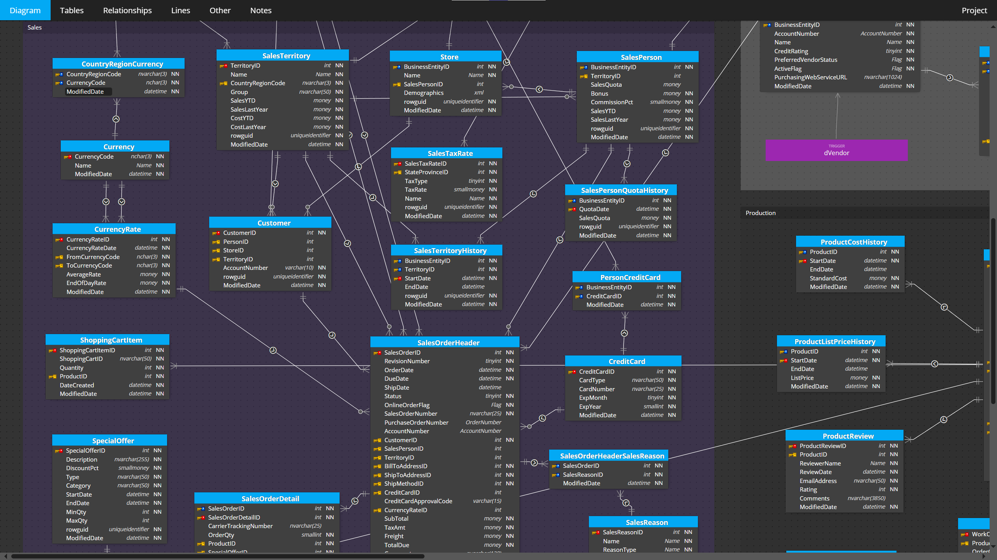

Slide 10
Are these schemas capturing *all* of the critical system state?
I see lots of nouns…
What about the verbs?

Slide 11
func (cs *checkoutService) PlaceOrder(ctx context.Context, req *pb.PlaceOrderRequest) (*pb.PlaceOrderResponse, error) {
orderID, err := uuid.NewUUID()
if err != nil { return nil, status.Errorf(codes.Internal, "failed to generate order uuid") }
prep, err := cs.prepareOrderItemsAndShippingQuoteFromCart(ctx, req.UserId, req.UserCurrency, req.Address)
if err != nil { return nil, status.Errorf(codes.Internal, err.Error()) }
total := cs.calculateOrderTotal(req, prep)
txID, err := cs.chargeCard(ctx, &total, req.CreditCard)
if err != nil { return nil, status.Errorf(codes.Internal, "failed to charge card: %+v", err) }
shippingTrackingID, err := cs.shipOrder(ctx, req.Address, prep.cartItems)
if err != nil { return nil, status.Errorf(codes.Unavailable, "shipping error: %+v", err) }
_ = cs.emptyUserCart(ctx, req.UserId)
orderResult := cs.createOrderResult(orderID, shippingTrackingID, prep, req)
if err := cs.sendOrderConfirmation(ctx, req.Email, orderResult); err != nil {
log.Warnf("failed to send order confirmation to %q: %+v", req.Email, err)
} else { log.Infof("order confirmation email sent to %q", req.Email) }
resp := &pb.PlaceOrderResponse{Order: orderResult}
return resp, nil
}
https://github.com/GoogleCloudPlatform/microservices-demo

Slide 12
func (cs *checkoutService) PlaceOrder(ctx context.Context, req *pb.PlaceOrderRequest) (*pb.PlaceOrderResponse, error) {
orderID, err := uuid.NewUUID()
if err != nil { return nil, status.Errorf(codes.Internal, "failed to generate order uuid") }
prep, err := cs.prepareOrderItemsAndShippingQuoteFromCart(ctx, req.UserId, req.UserCurrency, req.Address)
if err != nil { return nil, status.Errorf(codes.Internal, err.Error()) }
total := cs.calculateOrderTotal(req, prep)
txID, err := cs.chargeCard(ctx, &total, req.CreditCard)
if err != nil { return nil, status.Errorf(codes.Internal, "failed to charge card: %+v", err) }
shippingTrackingID, err := cs.shipOrder(ctx, req.Address, prep.cartItems)
if err != nil { return nil, status.Errorf(codes.Unavailable, "shipping error: %+v", err) }
_ = cs.emptyUserCart(ctx, req.UserId)
orderResult := cs.createOrderResult(orderID, shippingTrackingID, prep, req)
if err := cs.sendOrderConfirmation(ctx, req.Email, orderResult); err != nil {
log.Warnf("failed to send order confirmation to %q: %+v", req.Email, err)
} else { log.Infof("order confirmation email sent to %q", req.Email) }
resp := &pb.PlaceOrderResponse{Order: orderResult}
return resp, nil
}
https://github.com/GoogleCloudPlatform/microservices-demo

Slide 13
func (cs *checkoutService) PlaceOrder(ctx context.Context, req *pb.PlaceOrderRequest) (*pb.PlaceOrderResponse, error) {
orderID, err := uuid.NewUUID()
if err != nil { return nil, status.Errorf(codes.Internal, "failed to generate order uuid") }
prep, err := cs.prepareOrderItemsAndShippingQuoteFromCart(ctx, req.UserId, req.UserCurrency, req.Address)
if err != nil { return nil, status.Errorf(codes.Internal, err.Error()) }
total := cs.calculateOrderTotal(req, prep)
txID, err := cs.chargeCard(ctx, &total, req.CreditCard)
if err != nil { return nil, status.Errorf(codes.Internal, "failed to charge card: %+v", err) }
shippingTrackingID, err := cs.shipOrder(ctx, req.Address, prep.cartItems)
if err != nil {
cs.revertCharge(ctx, &txID, &total, req.CreditCard);
return nil, status.Errorf(codes.Unavailable, "shipping error: %+v", err)
}
_ = cs.emptyUserCart(ctx, req.UserId)
orderResult := cs.createOrderResult(orderID, shippingTrackingID, prep, req)
if err := cs.sendOrderConfirmation(ctx, req.Email, orderResult); err != nil {
log.Warnf("failed to send order confirmation to %q: %+v", req.Email, err)
} else { log.Infof("order confirmation email sent to %q", req.Email) }
resp := &pb.PlaceOrderResponse{Order: orderResult}
return resp, nil
}
https://github.com/GoogleCloudPlatform/microservices-demo

Slide 14
Process execution state is critical state.
If your system doesn’t store it durably, your system is not reliable.
can be

Slide 15
Durable Execution Constructs
Workflow
Comprised of steps
Guaranteed to run to completion
Automatically restarted on reboot
if interrupted
Execution resumes from last completed step
Must be deterministic
Input parameters and return value must be serializable
Step
Checkpointed after execution
Verified before execution
Can be nondeterministic
Return value must be serializable

Slide 16
Durable Execution Constructs
Workflow
Step 1
Step 2
Step 3
Step 4
Durable Storage

Slide 17

Durable Execution Constructs
Workflow
Step 1
Step 2
Step 3
Step 4
Durable Storage

Slide 18
Durable “Hello, World!” with DBOS
url = "postgresql://localhost/hello_world_sys_db”
config: DBOSConfig = {
"name": "dbos-app-starter",
"system_database_url": url ,
}
DBOS(config=config)
@DBOS.workflow()
def workflow():
step_one()
DBOS.set_event(steps_event, 1)
step_two()
DBOS.set_event(steps_event, 2)
step_three()
DBOS.set_event(steps_event, 3)
@DBOS.step()
def step_one():
time.sleep(5)
DBOS.logger.info("Completed step 1!")
@DBOS.step()
def step_two():
time.sleep(5)
DBOS.logger.info("Completed step 2!")
@DBOS.step()
def step_three():
time.sleep(5)
DBOS.logger.info("Completed step 3!")
https://github.com/dbos-inc/dbos-demo-apps/blob/main/python/dbos-app-starter/

Slide 19
@DBOS.workflow()
def checkout_workflow():
order_id = create_order()
inventory_reserved = reserve_inventory()
if not inventory_reserved:
DBOS.logger.error(f"Failed to reserve inventory for order {order_id}")
update_order_status(order_id=order_id, status=OrderStatus.CANCELLED.value)
DBOS.set_event(PAYMENT_ID, None)
return
DBOS.set_event(PAYMENT_ID, DBOS.workflow_id)
payment_status = DBOS.recv(PAYMENT_STATUS)
if payment_status == "paid":
DBOS.logger.info(f"Payment successful for order {order_id}")
update_order_status(order_id=order_id, status=OrderStatus.PAID.value)
DBOS.start_workflow(dispatch_order_workflow, order_id)
else:
DBOS.logger.warning(f"Payment failed for order {order_id}")
undo_reserve_inventory()
update_order_status(order_id=order_id, status=OrderStatus.CANCELLED.value)
DBOS.set_event(ORDER_ID, str(order_id))
https://github.com/dbos-inc/dbos-demo-apps/blob/main/python/widget-store

Slide 20
Additional DBOS Features
PostgreSQL system database
Embedded, not external
Transaction Steps
Queues and Concurrency
Scheduled Workflows (aka durable cron)
Workflow Communication (messaging, events & streaming)
Workflow Management (cancel/resume/fork)
Cloud Console
Conductor (self hosting + cloud console management)
Replay Debugger for VS Code

Slide 21
Demos (time permitting)

Slide 22
Remember engineers, the only difference between screwing around and a reliable system is persisting *all* critical state in durable storage.
- Harry Pierson
harry.pierson@dbos.dev
@devhawk.net

